Slide 1
Contents
Glossary or Formula Page
Page
Date
Description
2
3

Slide 2
Tasks
24
7
30
Essential Question
Questions
Notes
Summary

Slide 3
24
7
30
Date
Sorting Data
EQ – What are some simple way to sort and display data?

Slide 4
24
7
30
Date
Sorting Data
EQ – What are some simple way to sort and display data?
What is Statistical Data?

Slide 5
24
7
30
Date
Sorting Data
EQ – What are some simple way to sort and display data?
What is Statistical Data?
Statistical data is information gathered by observation, survey or measurement

Slide 6
24
7
30
Date
Sorting Data
EQ – What are some simple way to sort and display data?
What is Statistical Data?
Statistical data is information gathered by observation, survey or measurement
What is a frequency Table?

Slide 7
24
7
30
Date
Sorting Data
EQ – What are some simple way to sort and display data?
What is Statistical Data?
Statistical data is information gathered by observation, survey or measurement
What is a frequency Table?
A table showing all possible scores in one column and the frequency of each score in another column

Slide 8
24
7
30
Date
Sorting Data
EQ – What are some simple way to sort and display data?
What is Statistical Data?
Statistical data is information gathered by observation, survey or measurement
What is a frequency Table?
A table showing all possible scores in one column and the frequency of each score in another column
A frequency table displays data by showing the number of values within a set of categories or class intervals.
It may include a tally column to help count the data.

Slide 9
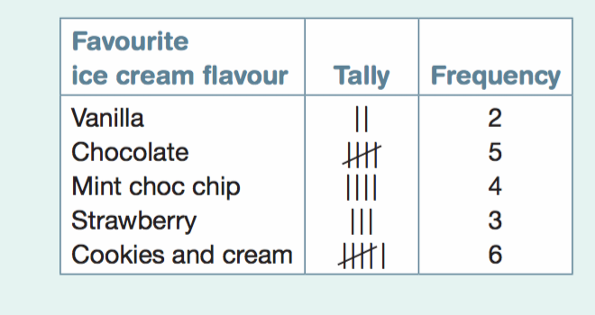
24
7
30
Date
Sorting Data
EQ – What are some simple way to sort and display data?
What is Statistical Data?
Statistical data is information gathered by observation, survey or measurement
What is a frequency Table?
A table showing all possible scores in one column and the frequency of each score in another column
A frequency table displays data by showing the number of values within a set of categories or class intervals.
It may include a tally column to help count the data.

Slide 10
24
7
30
Date
Sorting Data
EQ – What are some simple way to sort and display data?
What is a Column Graph?

Slide 11
24
7
30
Date
Sorting Data
EQ – What are some simple way to sort and display data?
What is a Column Graph?
A Column graph is a graphical representation of a single set of categorical or discrete data, where columns are used to show the frequency of scores

Slide 12
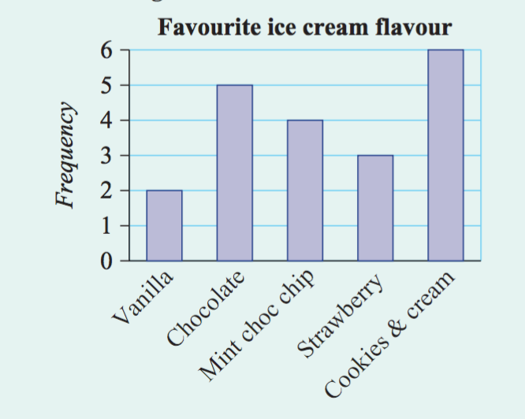
24
7
30
Date
Sorting Data
EQ – What are some simple way to sort and display data?
What is a Column Graph?
A Column graph is a graphical representation of a single set of categorical or discrete data, where columns are used to show the frequency of scores

Slide 13
24
7
30
Date
Sorting Data
EQ – What are some simple way to sort and display data?
What is a Histogram?

Slide 14
24
7
30
Date
Sorting Data
EQ – What are some simple way to sort and display data?
What is a Histogram?
A Histogram is a special type of column graph with no gaps between the columns; it can represent class intervals

Slide 15
24
7
30
Date
Sorting Data
EQ – What are some simple way to sort and display data?
What is a Histogram?
A Histogram is a special type of column graph with no gaps between the columns; it can represent class intervals
Histograms can be used for grouped discrete or continuous numerical data. The frequency of particular class intervals is recorded.

Slide 16
24
7
30
Date
Sorting Data
EQ – What are some simple way to sort and display data?
What is a Histogram?
A Histogram is a special type of column graph with no gaps between the columns; it can represent class intervals
Histograms can be used for grouped discrete or continuous numerical data. The frequency of particular class intervals is recorded.
The interval 10– (below) includes all numbers from 10 (including 10) to less than 20.

Slide 17
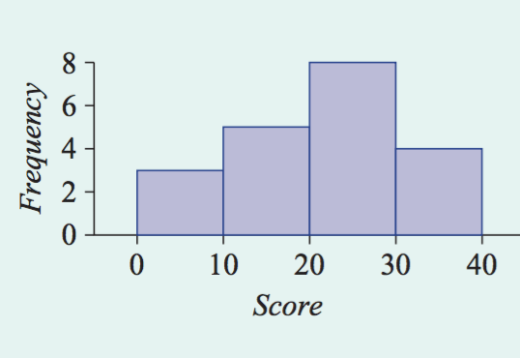
24
7
30
Date
Sorting Data
EQ – What are some simple way to sort and display data?
What is a Histogram?
A Histogram is a special type of column graph with no gaps between the columns; it can represent class intervals
Histograms can be used for grouped discrete or continuous numerical data. The frequency of particular class intervals is recorded.
The interval 10– (below) includes all numbers from 10 (including 10) to less than 20.

Slide 18
24
7
30
Date
Sorting Data
EQ – What are some simple way to sort and display data?
What is a Percentage Frequency?

Slide 19
24
7
30
Date
Sorting Data
EQ – What are some simple way to sort and display data?
What is a Percentage Frequency?
The percentage frequency is calculated as
%Frequency = Frequency × 100%.
Total

Slide 20
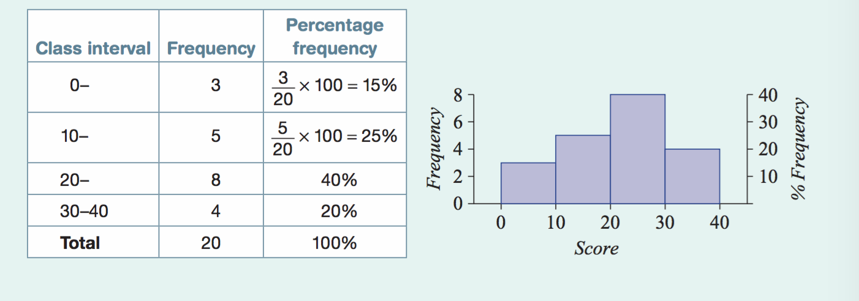
24
7
30
Date
Sorting Data
EQ – What are some simple way to sort and display data?
What is a Percentage Frequency?
The percentage frequency is calculated as
%Frequency = Frequency × 100%.
Total

Slide 21
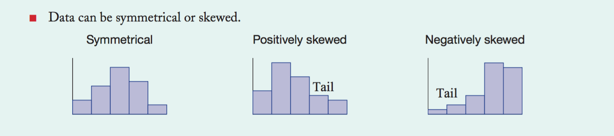
24
7
30
Date
Sorting Data
EQ – What are some simple way to sort and display data?

Slide 22
Notes Review
24, 7 ,30
Date
Title
Essential question
Notes complete
Notes complete with colour and diagrams
Questions completed
Contents page filed in
Formula page filled in

Slide 23
Homework
Review your notes and write a summary answering the essential question.

